Slide 1
Comparative Analysis of Depreciation Methods: Straight-Line vs. Diminishing Balance.
Automated Financial Modeling using Excel.

Slide 2
Introduction
Objective :
To determine the most suitable depreciation strategy based on asset utility and lifespan.
Depreciation is the systematic allocation of the cost of a tangible asset over its useful life.

Slide 3
Methodologies & Approaches
Problem Statement
Comparison of 2 distinct algorithms for asset valuation.
Method 1 : Straight-Line Method
Logic : Assumes Consistent utility over time.
Formula : (Cost – Scrap)/Life
Method 2 : Diminishing Balance Method
Logic : Assumes rapid loss of value (obsolescence) in early years.
Formula : Book Value * Rate

Slide 4
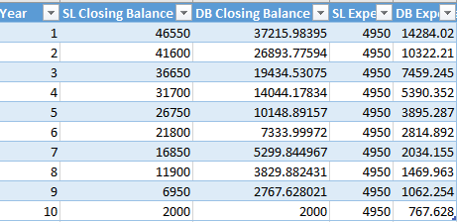
The Data Model (Stimulation)

Slide 5
Data Model Observations :
Key Data Points
Asset Cost : $ 51500
Scrap Value : $ 2000
Life Span : 10 Years
Observations
Year 1 closing balance for both :
1 . SL : $ 46,550
2. DB :$ 37,337

Slide 6
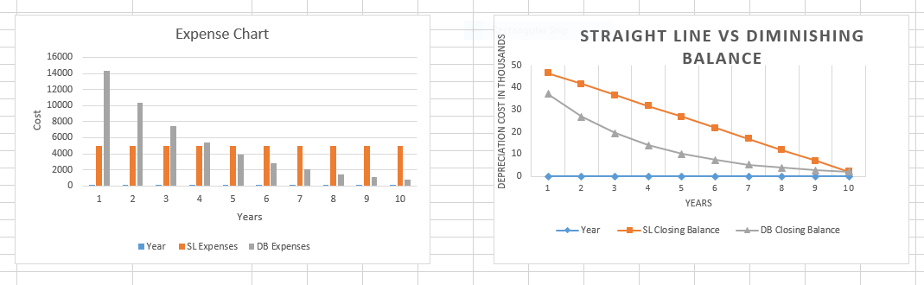
Comparative Visual Analysis

Slide 7
Comparative Visual Analysis
Analysis of the Graph
The SL Line is linear and predictable.
The DB Line is exponential, showing a steep decline in Years 1-3.
Insights : The Crossover Point (Where lines intersects), indicates where assets shift from high value to Maintenance mode.

Slide 8
Key Findings and Insights
Finding 1 (Total Cost)
Both methods result in the exact same total depreciation expense over the full life span ($49,500). The difference is only when the expense is recognize d.
Finding 2 : Cash-Flow
DB Method : Front-loads the expense. Good for reducing tax liability in early profitable years.
SL Method : Smooths the expense. Good for consistent profit reporting.

Slide 9
Conclusion and Actionable Recommendation
When to use Diminishing Balance Method
Recommendation : Use when assets are prone to rapid obsolescence (Laptops, Vehicles, Machinery).
Why : Matches the expense to the period of highest efficiency and value.
When to use Straight line Method
Recommendation : Use for asset with consistent utility.
Why : Simple calculations, matches consistent usage.

